Slide 1
We will get started shortly.
International Science Nutrition Society – CURARE CAUSAM - ISNS 2023

Slide 2
ISNS CASE STUDY
With Dr. Norbert Ketskes on Non-Hodgkin’s Lymphoma
International Science Nutrition Society – CURARE CAUSAM - ISNS 2023

Slide 3
Medical Disclaimer
The information provided is for educational purposes and is not intended as medical advice, or a substitute for the medical advice of a physician or other qualified health care professional. This is for science and educational purposes only and cannot be used in any aspect for sales or marketing. You should not use this information for diagnosing a health or fitness problem or disease. You should always consult with a doctor or other health care professional for medical advice or information about diagnosis and treatment. This is Confidential. Do not distribute—for scientific educational purposes only.
International Science Nutrition Society – CURARE CAUSAM - ISNS 2023

Slide 5
DR. NORBERT KETSKÉS, MD
Dr. Norbert Ketskés M.D. is one the most acknowledged gastroenterologist in Hungary, specializing in natural and organic nutritional solutions, leading the well-known Primus Labor, a private clinic offering personalized nutritional advices to its patients.
Scientific Adviser of ISNS
Medical Partner of the Hungarian Olympic Committee since 2015
Member of the Medical board of Hungarian Karate Association since 2015
Leader of the Primus Labor Private Medical Clinic since 2013
Working as a Family Doctor 1999 – 2012
International Science Nutrition Society – CURARE CAUSAM - ISNS 2023

Slide 6
CSISZTU ZSUZSA
Television - Presenter, Anchor, Editor, Journalist and Sports Lawyer, Sport-diplomat
Spokesperson of the Giro d’Italia Grande Partenza, (Road-Cycling World -Tour Championship)
Spokesperson of the FINA (Swimming and Waters poets World Championship)
2022 Vice-President of the Hungarian Sports Journalists’ Association
Member of the Hungarian Olympic Committee Member of the Advisory Board of the Hungarian Olympic Academy
Newly Elected Vice-President of the International Sports Journalists Association, the first female ever in the field from her homeland, and third globally since 1924 (AIPS)
International Science Nutrition Society – CURARE CAUSAM - ISNS 2023

Slide 7
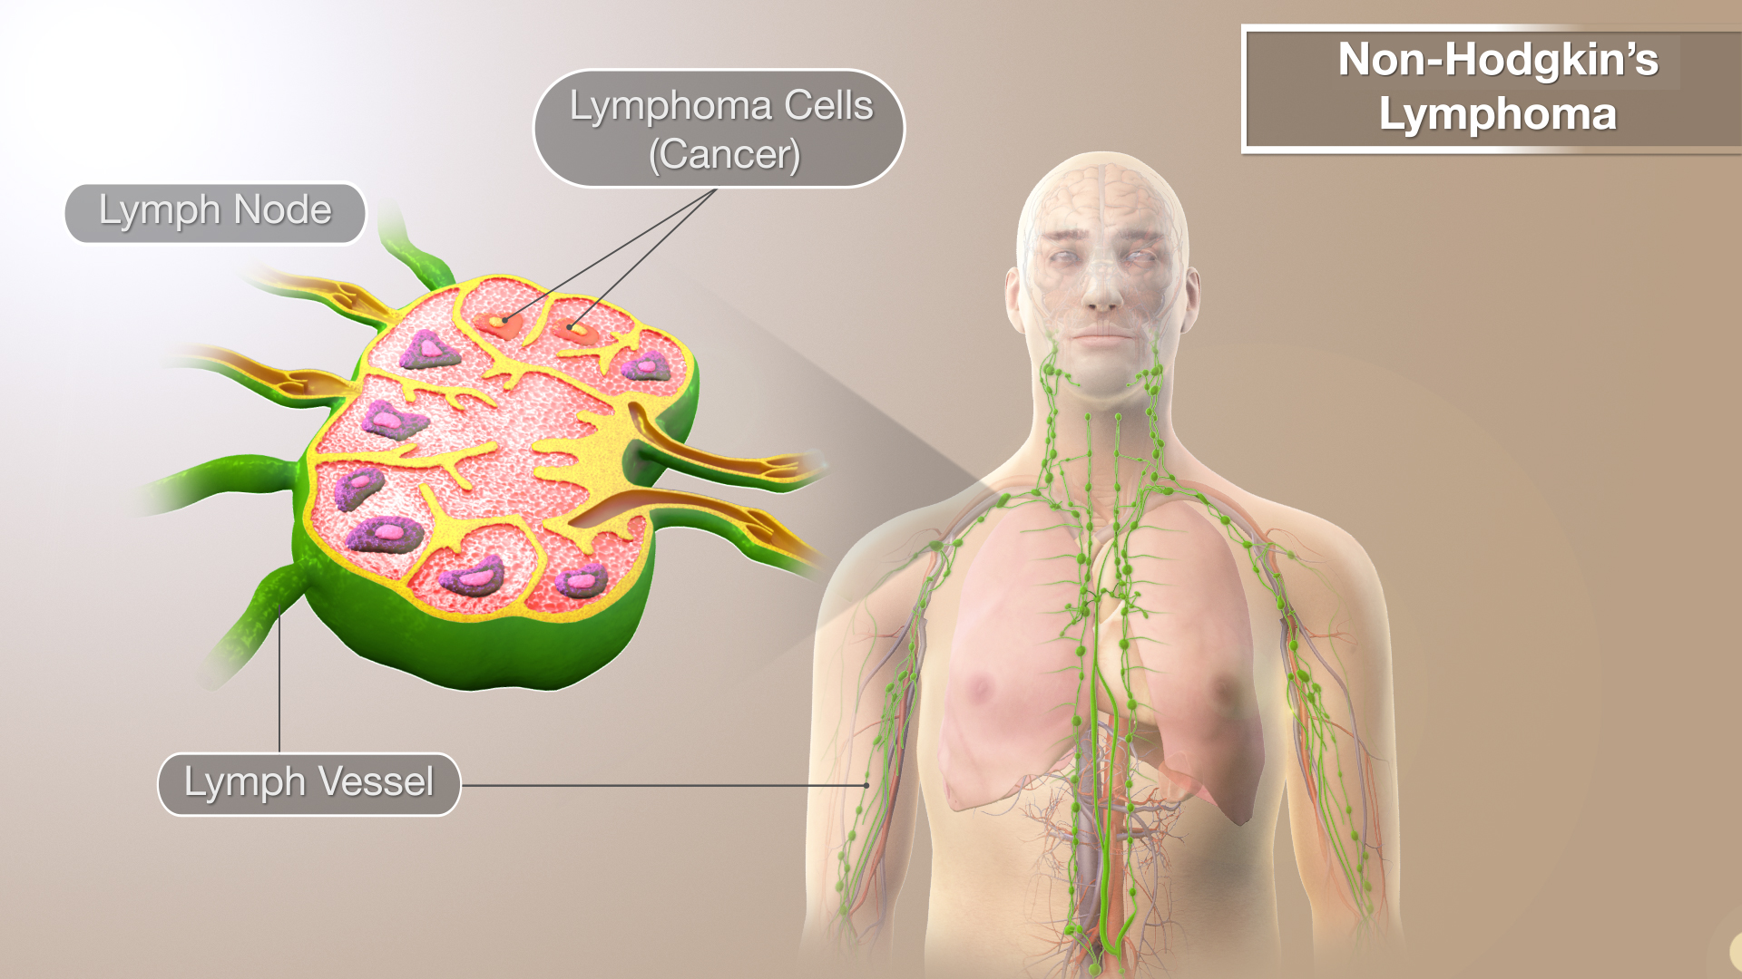
What is Non-Hodgkin’s Lymphoma?
Normally, lymphocytes (it belongs to white blood cells) go through a predictable life cycle. Old lymphocytes die, and your body creates new ones to replace them. In non-Hodgkin’s lymphoma, the lymphocytes don’t die, and your body keeps creating new ones. This oversupply of lymphocytes crowds into your lymph nodes, causing them to swell.
Non-Hodgkin’s lymphoma is a type of cancer that begins in your lymphatic system, which is part of the body’s germ-fighting immune system.
International Science Nutrition Society – CURARE CAUSAM - ISNS 2023

Slide 8
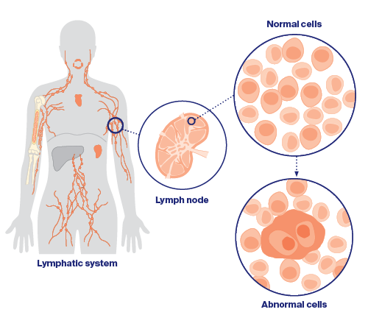
Non-Hodgkin’s Lymphoma
Non-Hodgkin’s lymphoma (NHL) is a term used for many different types of lymphoma that all share some of the same characteristics. NHL most often affects adults, but children can get it too.
Lymphoma can start anywhere in the body where lymph tissue is found. The major sites of lymph tissue are:
Lymph nodes: are bean-sized collections of lymphocytes and other immune system cells throughout the body
Spleen: which is an organ under the lower ribs on the left side of the body. The spleen makes lymphocytes and other immune cells
Bone marrow: is a spongy tissue inside certain bones. This is where new blood cells are made
Thymus: is a small organ behind the upper part of the breastbone and is in front of the heart.
Adenoids and tonsils: are collections of lymph tissue in the back of the throat. They help make antibodies against germs that are inhaled or swallowed
Digestive tract: the stomach, intestines, and many other organs also have lymph tissue
International Science Nutrition Society – CURARE CAUSAM - ISNS 2023

Slide 9
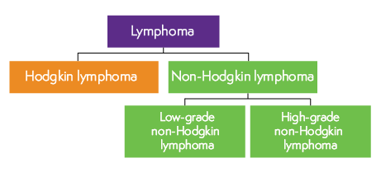
Types of Non-Hodgkin’s Lymphoma
Non-Hodgkin’s lymphoma is a general category of lymphoma. There are many subtypes that fall into this category.
Diffuse large B-cell lymphoma- the most common type of NHL and is marked by rapidly growing tumors in the lymph nodes, spleen, liver, bone marrow, or other tissues and organs
Follicular lymphoma- is the most common type of low-grade NHL and develops when white blood cells cluster together to form lumps in your lymph glands or organs
These are among the most common subtypes
The other general category of lymphoma is Hodgkin’s Lymphoma
Advances in diagnosis and treatment of non-Hodgkin’s lymphoma have helped improve the prognosis for people with this disease
International Science Nutrition Society – CURARE CAUSAM - ISNS 2023

Slide 10
Indolent vs. Aggressive Lymphomas
Types of NHL can also be grouped based on how fast they grow and spread:
Indolent lymphomas grow and spread slowly. Some indolent lymphomas might not need to be treated right away but can be watched closely instead. The most common type of indolent lymphoma in the United States is follicular lymphoma
Aggressive lymphomas grow and spread quickly, and usually need to be treated right away. The most common type of aggressive lymphoma in the United States is diffuse large cell B cell lymphoma (DLBCL)
Some types of lymphoma, like mantle cell lymphoma, don’t fit neatly into either of these categories
International Science Nutrition Society – CURARE CAUSAM - ISNS 2023

Slide 11
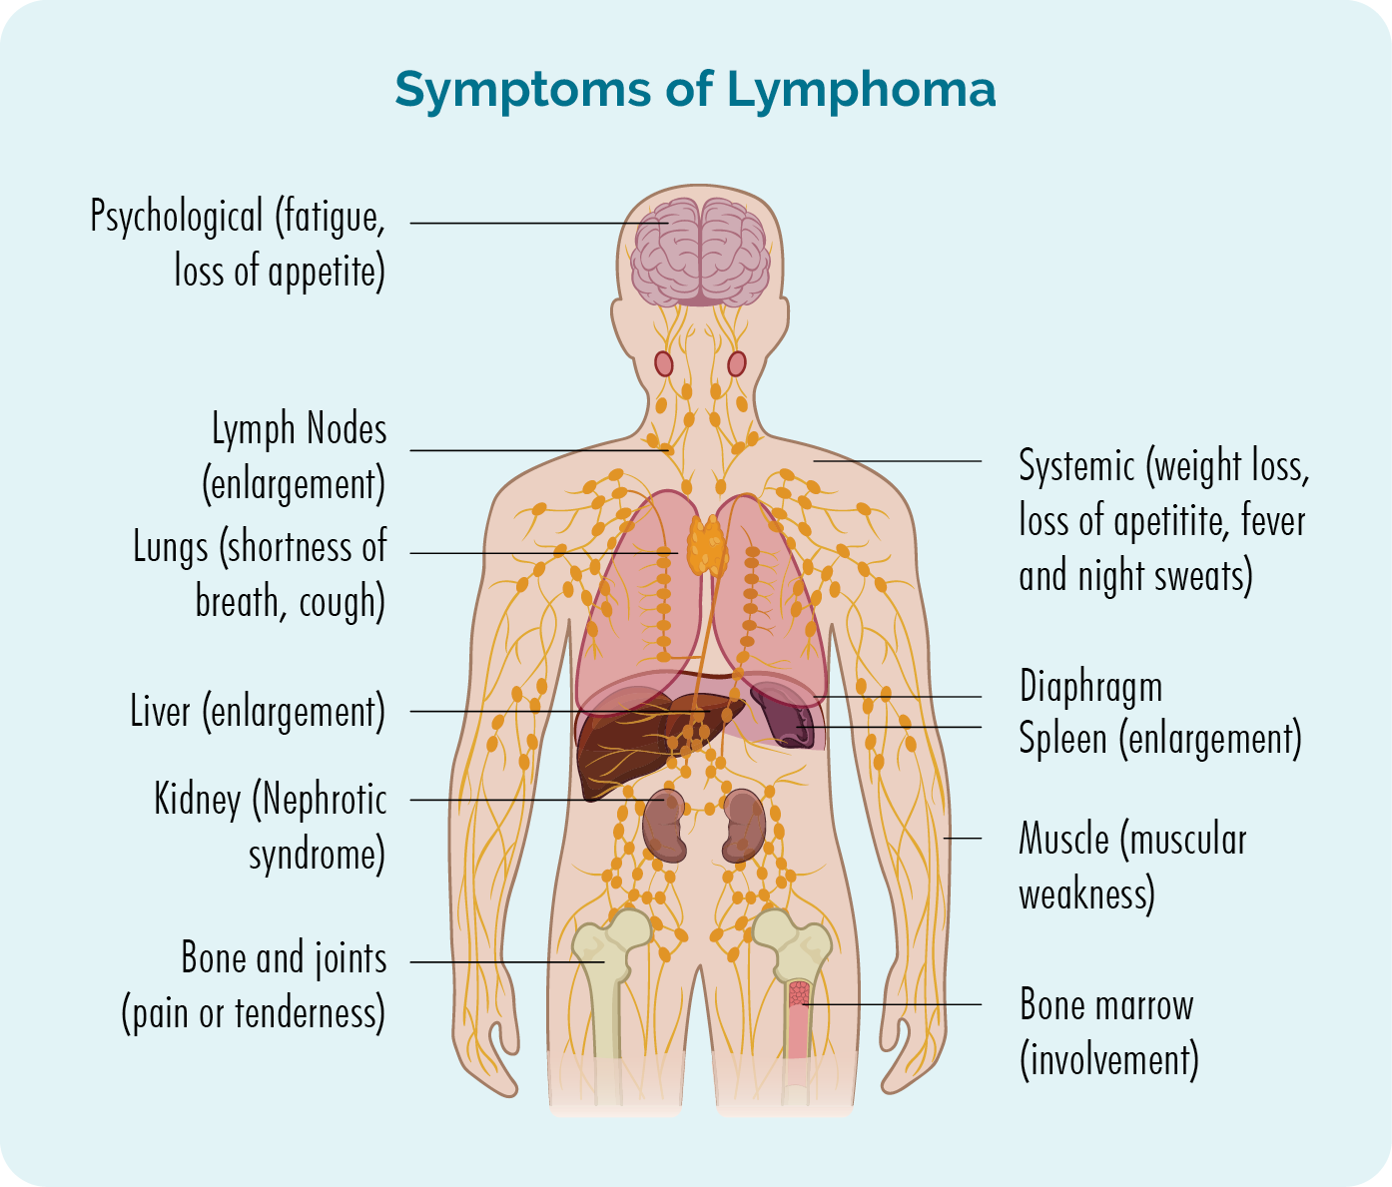
What are the symptoms of NHL?
Signs and symptoms of non-Hodgkin’s lymphoma may include:
Swollen lymph nodes in your neck, armpits, or groin
Abdominal pain or swelling
Chest pain, coughing or trouble breathing
Persistent fatigue
Fever
Night sweats
Unexplained weight loss
International Science Nutrition Society – CURARE CAUSAM - ISNS 2023

Slide 12
Risk Factors for NHL
Most people diagnosed with non-Hodgkin’s lymphoma don’t have any obvious risk factors. Many people who have risk factors for the disease never develop it.
Some risk factors that may increase the risk for no—Hodgkin’s lymphoma includes:
Medications that suppress your immune system – if you have had an organ transplant and take medications that control your immune system, you might have an increased risk of non-Hodgkin’s lymphoma
Infection with certain viruses and bacteria- certain viral and bacterial infections appear to increase the risk of non-Hodgkin’s lymphoma. Viruses linked to this type of cancer include HIV and Epstein-Barr infection. Bacteria linked to non-Hodgkin’s lymphoma include the ulcer-causing Helicobacter pylori
Chemicals – certain chemicals, such as those used to kill insects and weeds, may increase your risk of developing non-Hodgkin’s lymphoma. More research is needed to understand the possible link between pesticides and the development of non-Hodgkin’s lymphoma
Older age – Non-Hodgkin’s lymphoma can occur at any age, but the risk increases with age. It is most common in people 60 and over.
International Science Nutrition Society – CURARE CAUSAM - ISNS 2023

Slide 13
CASE STUDY
Patient: Female
Age: 52 years old
History: Family history is negative
Medical history:
In 2021, she was diagnosed with Non-Hodgkin lymphoma
(histological dg: low-grade, follicular)
Clinical tests:
PET scan: Multiple involvement
Laboratory: there was no major difference
Symptoms:
Swollen, small lymph nodes in the neck and all over the body
Persistent fatigue
Night sweats
She goes for a check-up at the hospital every quarter, the last 3 times she has developed swollen lymph nodes in more and more places
International Science Nutrition Society – CURARE CAUSAM - ISNS 2023

Slide 14
Conventional Treatment
Several non-Hodgkin’s lymphoma treatments are available. Which treatment or combination of treatments is best for you will depend on the specifics of your lymphoma.
- If your lymphoma appears to be slow growing (indolent) and does not
cause signs and symptoms, you may not need to be treated right away.
Chemotherapy is a common initial treatment for non-Hodgkin’s lymphoma. It might also be an option if your lymphoma comes back after your initial treatments
For people with non-Hodgkin’s lymphoma, chemotherapy is also used as part of a bone marrow transplant, also known as a stem cell transplant.
Radiation therapy uses high-powered energy beams, such as x-rays and protons, to kill cancer cells.
For certain types of non-Hodgkin’s lymphoma, radiation therapy may be the only treatment you need, particularly if your lymphoma is slow growing and located in one or two spots
Targeted drug therapy treatments focus on specific abnormalities present within cancer cells by blocking these abnormalities, targeted drug treatments can cause cancer cells to die.
Immunotherapy uses your immune system to fight cancer. Your body’s disease-fighting immune system may not attack your cancer because the cancer cells produce proteins that help them hide from the immune system cells. Immunotherapy works by interfering with that process.
Immunotherapy drugs may be an option for certain types of non-Hodgkin’s lymphoma if other treatments have not helped
She does not receive special medication, and occasionally receives steroid injection treatment
International Science Nutrition Society – CURARE CAUSAM - ISNS 2023

Slide 15
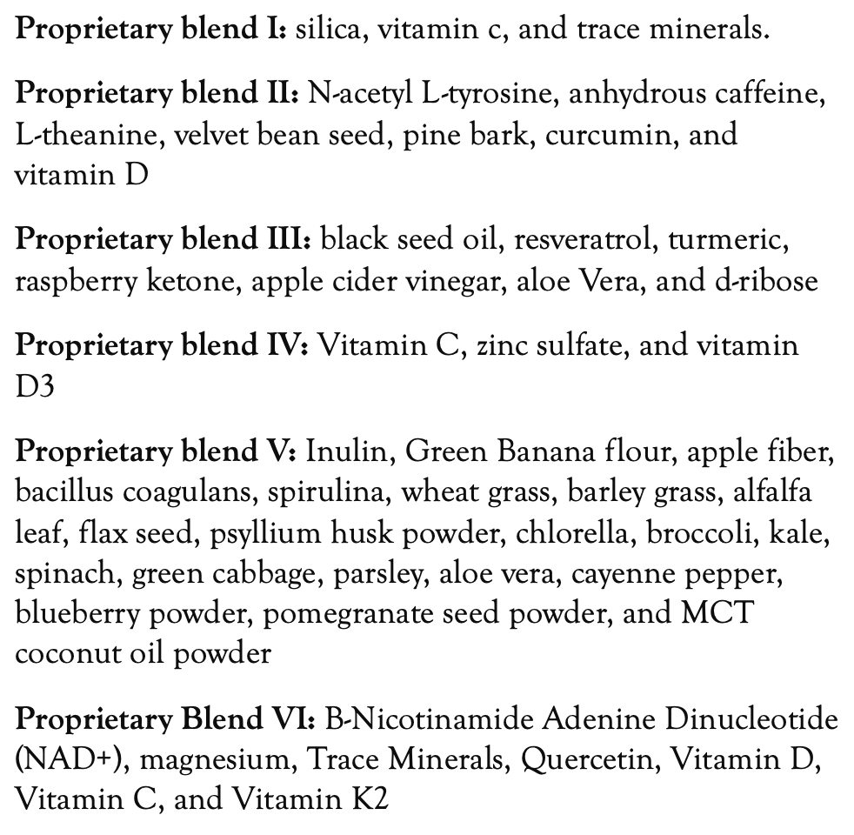
Method
PROPRIETARY BLENDS LEGEND
Proprietary blend I: 2x5 drops, morning and
evening, for 3 days, then every 3 days then
increased by 1-1 drops every 3 days to 2x12
Proprietary blend III: 1/2 sachet in the morning for 7 days then 1 sachet in the morning for 7 days then 1 sachet in the morning and 1 sachet in the evening for 7 days then 2 sachet in the morning and 1 sachet in the evening
Proprietary blend IV: 1 teaspoon in the
morning
Proprietary blend V: 1 teaspoon in the
in the evening for 7 days, then 1 teaspoon in
the morning and 1 teaspoon in the evening
Proprietary blend VI: 1 in the
morning for 7 days then 1 in the morning
and 1 in the evening for 7 days then 2 in the
morning and 2 in the evening
International Science Nutrition Society – CURARE CAUSAM - ISNS 2023

Slide 16
Additional Treatment
Exercises to achieve a positive mental and emotional state
(e.g: Yoga, meditation, breathing exercises, stress management)
A special diet based on my personal experience (more than 10 years)
(e.g: refined carbohydrates and animal protein free, vegetable based, gluten-free)
International Science Nutrition Society – CURARE CAUSAM - ISNS 2023

Slide 17
Results
After 1 months:
fatigue and night sweats decreased
After 3 months:
fatigue and night sweats are gone
No new lymph node swelling developed, and the swelling of the existing ones also decreased!!!
Consciousness of illness has passed!!
International Science Nutrition Society – CURARE CAUSAM - ISNS 2023

Slide 18
Research Studies
International Science Nutrition Society – CURARE CAUSAM - ISNS 2023

Slide 19
Apoptotic Effect of Nigella sativa on Human Lymphoma U937 Cells Belkis Atasever Arslan, Fatma Busra Isik, Hazal Gur, Fatih Ozen, and Tunc Catal
In this study, we investigated selective cytotoxic and apoptotic effects of N. sativa extract and its apoptotic mechanisms on U937 cells. In addition, we also studied selective cytotoxic activity of thymoquinone that is the most active essential oil of N. sativa.
Our results showed that N. sativa extract has selective cytotoxicity and apoptotic effects on U937 cells but not ECV304 control cells.
N. sativa may have anticancer drug potential and trigger p53-induced apoptosis in U937 lymphoma cells.
https://www.ncbi.nlm.nih.gov/pmc/articles/PMC5669107/
International Science Nutrition Society – CURARE CAUSAM - ISNS 2023

Slide 20
The Multiple Mechanisms of Cell Death Triggered by Resveratrol in Lymphoma and Leukemia Raffaele Frazzi and Marco Tigano
In this paper, the main mechanisms of cell death triggered by or linked to- resveratrol are reviewed and discussed.
The main focus is on lymphoma and leukemia experimental models where resveratrol has been tested and investigated at the cellular, molecular or physiological levels.
The most relevant in vivo challenges involving resveratrol are also reported and analyzed in order to define the key features of this polyphenol and the potential for
the treatment of hematologic tumors.
The confirmed sensitivity of lymphoma and leukemia cells to RSV, together to the better knowledge of the actual molecular targets of this polyphenol, may lead to future useful applications.
https://www.ncbi.nlm.nih.gov/pmc/articles/PMC3975435/
International Science Nutrition Society – CURARE CAUSAM - ISNS 2023

Slide 21
The Role of Magnesium in Hypertension and Cardiovascular Disease Emily L Deubler, Susan M Gapstur, W Ryan Diver, Mia M Gaudet, James M Hodge, Victoria L Stevens, Marjorie L McCullough, Laura G Haines, Keith E Levine, Lauren R Teras
Cadmium and lead are persistent environmental toxins that are known or probable carcinogens, based on evidence for causality for nonhematologic cancers. Associations of these metals with risk of non-Hodgkin lymphoma (NHL) and multiple myeloma (MM) are unknown but biologically plausible.
Results from our study suggest a positive association between erythrocyte lead level and risk of lymphoid malignancies and a possible inverse association between cadmium and myeloma. Additional research is needed to confirm and further explore these findings.
https://pubmed.ncbi.nlm.nih.gov/32506449/
International Science Nutrition Society – CURARE CAUSAM - ISNS 2023

Slide 22
References
https://www.mayoclinic.org/diseases-conditions/non-hodgkins-lymphoma/symptoms-causes/syc-20375680
https://www.ncbi.nlm.nih.gov/pmc/articles/PMC5669107/
https://www.ncbi.nlm.nih.gov/pmc/articles/PMC3975435/
https://pubmed.ncbi.nlm.nih.gov/32506449/
International Science Nutrition Society – CURARE CAUSAM - ISNS 2023

Slide 23
Thank You for Joining Us This Week!!
International Science Nutrition Society – CURARE CAUSAM - ISNS 2023

